Slide 1
Classification

Slide 2
Classification vs. Prediction
Classification
  Predicts categorical class labels (discrete or nominal)
  Classifies data (constructs a model) based on the training set and the values (class labels) in a classifying attribute and uses it in classifying new data.
  For example, we can build a classification model to categorize bank loan applications as either safe or risky.
Prediction
  models continuous-valued functions, i.e., predicts unknown or missing values
Typical applications
  Credit approval
  Target marketing

Slide 3
Classification—A Two-Step Process
Data classification is a two-step process:
Learning step (where a classification model is constructed)
Classification step (where the model is used to predict class labels for given data).
In the learning step (or training phase), a classification algorithm builds the classifier by analyzing or “learning from” a training set.
A tuple, X, is represented by an N-dimensional attribute vector,
    X ={x1, x2,……..xN}
Each tuple, X, is assumed to belong to a predefined class as determined by another database attribute called the class label attribute.
The individual tuples making up the training set are referred to as training tuples and are randomly sampled from the database under analysis.

Slide 4
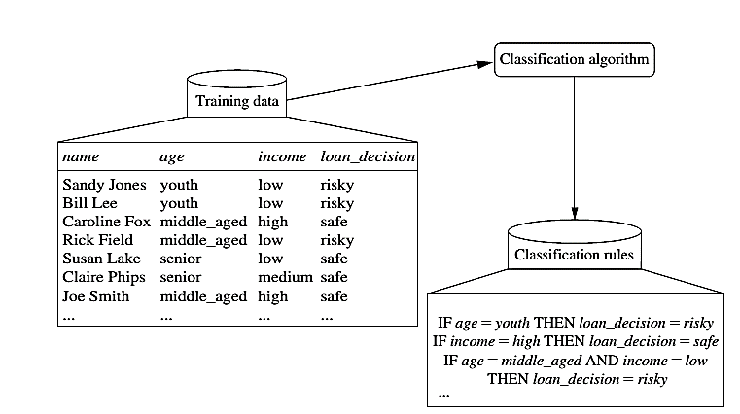
Learning

Slide 5
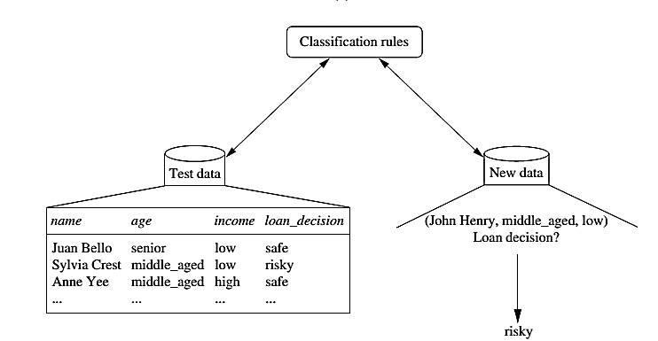
Classification

Slide 6



Process (1): Model Construction
Classification
Algorithms
Training
Data
Classifier
(Model)
IF rank = ‘professor’
OR years > 6
THEN tenured = ‘yes’

Slide 7


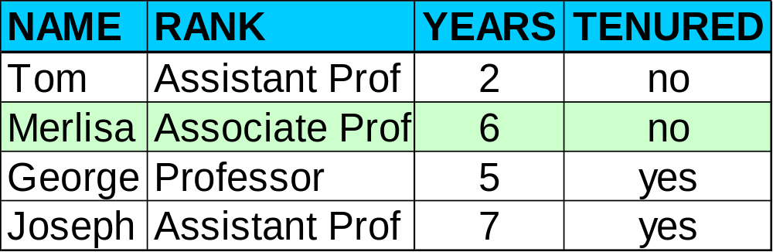

Process (2): Using the Model in Prediction
Classifier
Testing
Data
Unseen Data
(Jeff, Professor, 4)
Tenured?

Slide 8
Supervised vs. Unsupervised Learning
Supervised learning (classification)
  Supervision: The training data (observations, measurements, etc.) are accompanied by labels indicating the class of the observations
  New data is classified based on the training set
Unsupervised learning (clustering)
  The class labels of training data is unknown
  In this we can predict the class labels by using clustering technique.

Slide 9
Issues regarding Classification & Prediction

Slide 10
Issues: Data Preparation
Data cleaning
  Preprocess data in order to reduce noise and handle missing values
Relevance analysis (feature selection)
  Remove the irrelevant or redundant attributes
Data transformation
  Generalize and/or normalize data

Slide 11
Issues: Evaluating Classification Methods
Accuracy: classifier accuracy: predicting class label
Speed: time to construct the model (training time)
  time to use the model (classification/prediction time)
Robustness: handling noise and missing values
Scalability: efficiency in disk-resident databases
Other measures, e.g., goodness of rules, such as decision tree size or compactness of classification rules

Slide 12
Decision Tree Induction

Slide 13
Decision Tree Induction
Decision tree induction is the learning of decision trees from class-labeled training tuples.
A decision tree is a flowchart-like tree structure, where each internal node (non-leaf node) denotes a test on an attribute, each branch represents an outcome of the test, and each leaf node (or terminal node ) holds a class label.
The topmost node in a tree is the root node.

Slide 14
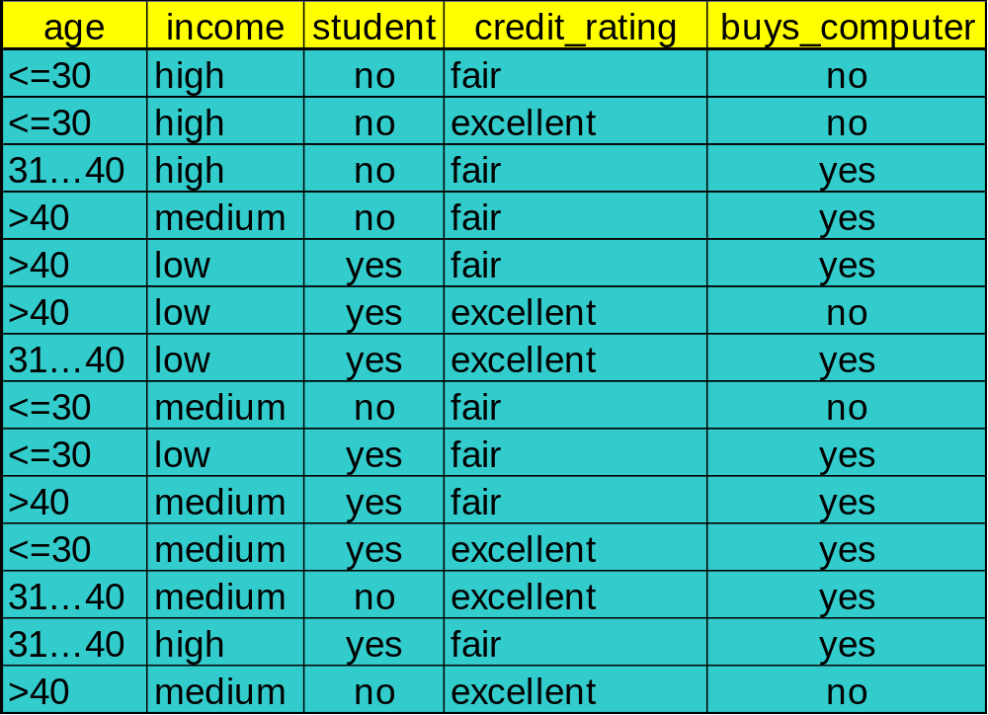
Decision Tree Induction: Training Dataset

Slide 15
Output: A Decision Tree for “buys_computer”
age?
<=30
>40
31….40
student?
yes
credit rating?
Excellent
Fair
NO
YES
no
yes
no
yes

Slide 16
How are decision trees used for classification?
Given a tuple, X, for which the associated class label is unknown.
The attribute values of the tuple are tested against the decision tree.
A path is traced from the root to a leaf node, which holds the class prediction for that tuple.
Decision trees can easily be converted to classification rules.

Slide 17
Why are decision tree classifiers so popular?
The construction of decision tree classifiers does not require any domain knowledge or parameter setting, and therefore is appropriate for exploratory knowledge discovery. Decision trees can handle multidimensional data.
Their representation of acquired knowledge in tree form is intuitive and generally easy to understand by humans.
The learning and classification steps of decision tree induction are simple and fast. In general, decision tree classifiers have good accuracy.

Slide 18
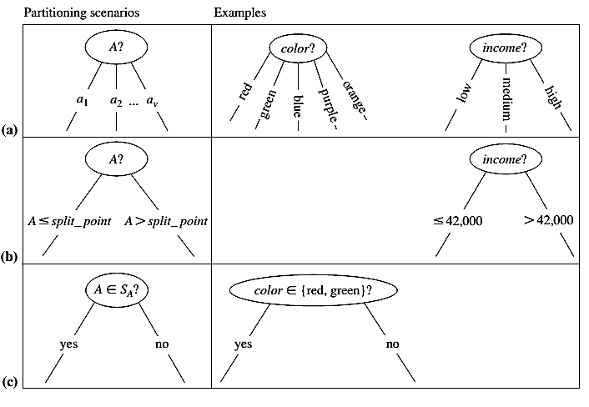
Attribute Selection Criteria
It is used to determine the splitting criterion.

Slide 19
Attribute Selection Criteria
A is discrete-valued: In this case, the outcomes of the test at node N correspond directly to the known values of A.
A is continuous-valued: In this case, the test at node N has two possible outcomes, corresponding to the conditions A <= split point and A >= split point, respectively.
A is discrete-valued in Set form.

Slide 20

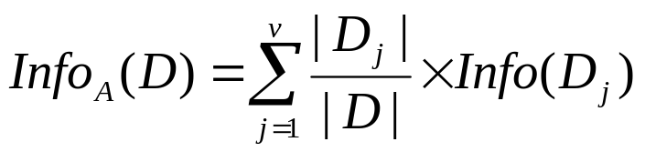

Attribute Selection Measure: Information Gain
Select the attribute with the highest information gain
Let p_{i} be the non- zero probability that an arbitrary tuple in D belongs to class C_{i}, estimated by |C_{i, D}|/|D|
Initial entropy:
A log function to the base 2 is used, because the information
is encoded in bits.
New entropy (after using A to split D into v partitions) to classify D:
Information gained by branching on attribute A
Notes:
I : the expected information needed to classify a given sample
E (entropy) : expected information based on the partitioning into subsets by A

Slide 21
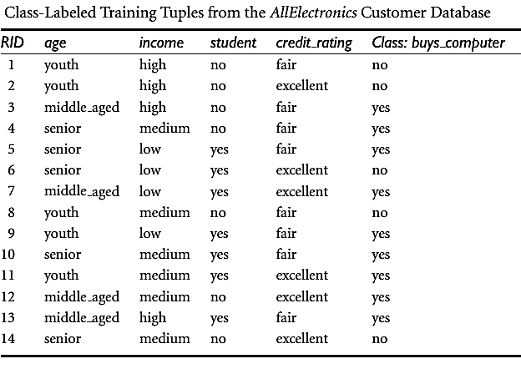
Attribute Selection Measure: Information Gain

Slide 22

Attribute Selection Measure: Information Gain
The class label attribute, buys_computer, has two distinct values (namely, {yes, no}); therefore, there are two distinct classes (i.e., m = 2).
There are nine tuples of class yes and five tuples of class no.

Slide 23

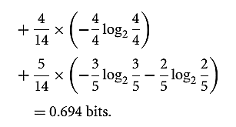


We need to look at the distribution of yes and no tuples for each category of age. For the age category “youth,” there are two yes tuples and three no tuples. For the category “middle aged,” there are four yes tuples and zero no tuples. For the category “senior,” there are three yes tuples and two no tuples.

Slide 24
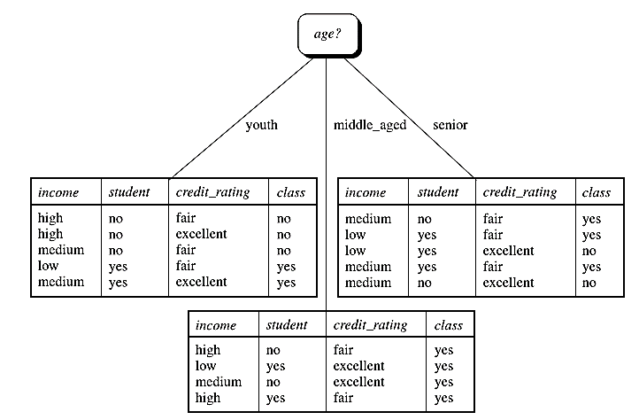

Slide 25
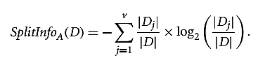

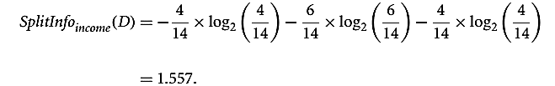
Attribute Selection Measure:
Gain Ratio
A test on income splits the data into three partitions, namely low, medium, and high, containing four, six, and four tuples, respectively.
Gain(Income) = 0.029
Gain Ratio (Income) = 0.029 / 1.557 = 0.019

Slide 26

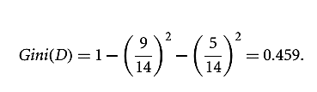
Attribute Selection Measure:
Gini Index
The Gini index is used in CART. Using the notation previously described, the Gini index measures the impurity of D, a data partition or set of training tuples, as

Slide 27
Over-fitting and Tree Pruning
Over-fitting: An induced tree may over-fit the training data
  Too many branches, some may reflect anomalies due to noise or outliers
Two approaches to avoid over-fitting
  Pre-pruning: Halt tree construction early—do not split a node if this would result in the goodness measure falling below a threshold
    Difficult to choose an appropriate threshold
  Post-pruning: Remove branches from a “fully grown” tree—get a sequence of progressively pruned trees
    Use a set of data different from the training data to decide which is the “best pruned tree”

Slide 28
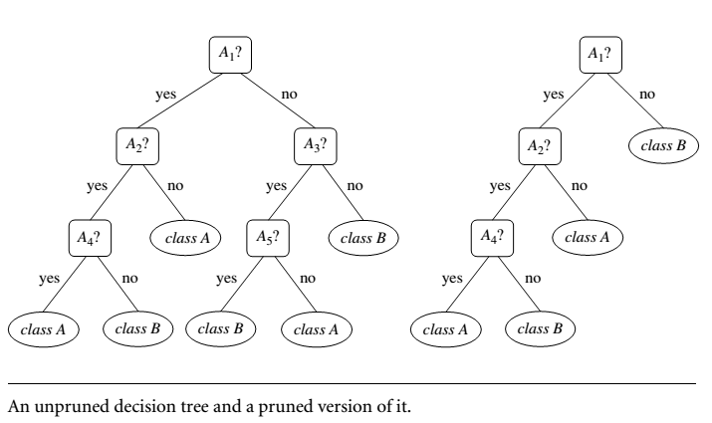
Example

Slide 29
Bayesian Classification

Slide 30
Bayesian Classification: Why?
It is a statistical classifier, it can predict class membership probabilities such as the probability that a given tuple belongs to a particular class.
It is based on Bayes’ Theorem.
A simple Bayesian classifier, naïve Bayesian classifier, has comparable performance with decision tree and selected neural network classifiers

Slide 31
Bayesian Theorem: Basics
Let X be a data sample (“evidence”): class label is unknown.
Let H be a hypothesis that X belongs to class C.
Classification is to determine P(H|X) is the posteriori probability, of H conditioned on X.
X is a 35-year-old customer with an income of $40,000.
Then P(H/X) reflects the probability that customer X will buy a computer given that we know the customer’s age and income.
In contrast, P(H) is the prior probability, of H .
For our example, this is the probability that any given customer will buy a computer, regardless of age, income, or any other information.
P(H), which is independent of X.

Slide 32
Bayesian Theorem: Basics
P(X|H) (posteriori probability), the probability of X conditioned on H. That is, it is the probability that a customer, X, is 35 years old and earns $40,000, given that we know the customer will buy a computer.
P(X) is the prior probability of X.
Using our example, it is the probability that a person from our set of customers is 35 years old and earns $40,000.

Slide 33
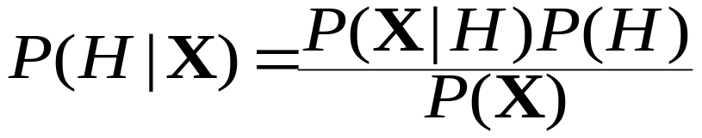
Bayesian Theorem
Given training data X, posteriori probability of a hypothesis H, P(H|X), follows the Bayes theorem

Slide 34


Derivation of Naïve Bayesian Classifier
Let D be a training set of tuples and their associated class labels, and each tuple is represented by an n-D attribute vector X = (x₁, x₂, …, x_{n})
Suppose there are m classes C₁, C₂, …, C_{m}.
Classification is to derive the maximum posteriori, i.e., the maximal P(C_{i}|X)
This can be derived from Bayes’ theorem
Since P(X) is constant for all classes, only
  needs to be maximized

Slide 35
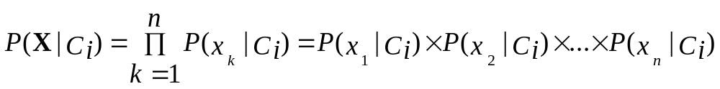
Derivation of Naïve Bayes Classifier
A simplified assumption: attributes are conditionally independent (i.e., no dependence relation between attributes):
For instance, to compute P(X/Ci), we consider the following:

Slide 36

Naïve Bayesian Classifier: Training Dataset
Class:
C1:buys_computer = ‘yes’
C2:buys_computer = ‘no’
Data sample
X = (age <=30,
Income = medium,
Student = yes
Credit_rating = Fair)

Slide 37
Naïve Bayesian Classifier: An Example
P(C_{i}): P(buys_computer = “yes”) = 9/14 = 0.643
P(buys_computer = “no”) = 5/14= 0.357
Compute P(X|C_{i}) for each class
P(age = “<=30” | buys_computer = “yes”) = 2/9 = 0.222
P(age = “<= 30” | buys_computer = “no”) = 3/5 = 0.6
P(income = “medium” | buys_computer = “yes”) = 4/9 = 0.444
P(income = “medium” | buys_computer = “no”) = 2/5 = 0.4
P(student = “yes” | buys_computer = “yes) = 6/9 = 0.667
P(student = “yes” | buys_computer = “no”) = 1/5 = 0.2
P(credit_rating = “fair” | buys_computer = “yes”) = 6/9 = 0.667
P(credit_rating = “fair” | buys_computer = “no”) = 2/5 = 0.4
X = (age <= 30 , income = medium, student = yes, credit_rating = fair)
P(X|C_{i}) : P(X|buys_computer = “yes”) = 0.222 x 0.444 x 0.667 x 0.667 = 0.044
P(X|buys_computer = “no”) = 0.6 x 0.4 x 0.2 x 0.4 = 0.019
P(X|C_{i})*P(C_{i}) : P(X|buys_computer = “yes”) * P(buys_computer = “yes”) = 0.028
P(X|buys_computer = “no”) * P(buys_computer = “no”) = 0.007
Therefore, X belongs to class (“buys_computer = yes”)

Slide 38
Naïve Bayesian Classifier: Comments
Advantages
  Easy to implement
  Good results obtained in most of the cases
Disadvantages
  Assumption: class conditional independence, therefore loss of accuracy
  Practically, dependencies exist among variables
    E.g., hospitals: patients: Profile: age, family history, etc.
    Symptoms: fever, cough etc., Disease: lung cancer, diabetes, etc.
    Dependencies among these cannot be modeled by Naïve Bayesian Classifier

Slide 39
Rule Based Classification

Slide 40
Using IF-THEN Rules for Classification
Rules are a good way of representing information or bits of knowledge. A rule-based classifier uses a set of IF-THEN rules for classification. An IF-THEN rule is an expression of the form
IF condition THEN conclusion
  R1: IF age = youth AND student = yes THEN buys_computer = yes
The “IF” part (or left side) of a rule is known as the rule antecedent or precondition. The “THEN” part (or right side) is the rule consequent.
In the rule antecedent, the condition consists of one or more attribute tests and the rule’s consequent contains a class prediction. R1 can also be written as:

Slide 41
Using IF-THEN Rules for Classification
If the condition holds true for a given tuple, we say that the rule antecedent is satisfied and that rule covers the tuple.
Assessment of a rule: coverage and accuracy
  n_{covers} = # of tuples covered by R
  n_{correct} = # of tuples correctly classified by R
  coverage(R) = n_{covers} / |D| /* D: training data set */
  accuracy(R) = n_{correct} / n_{covers}

Slide 42
Rule Extraction from a Decision Tree
age?
<=30
31..40
>40
Rules are easier to understand than large trees
One rule is created for each path from the root to a leaf
Each attribute-value pair along a path forms a conjunction: the leaf holds the class prediction
Rules are mutually exclusive and exhaustive
student?
yes
credit rating?
no
yes
excellent
fair
no
yes
no
yes
Example: Rule extraction from our buys_computer decision-tree
  IF age = young AND student = no THEN buys_computer = no
  IF age = young AND student = yes THEN buys_computer = yes
  IF age = mid-age THEN buys_computer = yes
  IF age = old AND credit_rating = excellent THEN buys_computer = no
  IF age = young AND credit_rating = fair THEN buys_computer = yes

Slide 43
Back Propagation

Slide 44
Classification by Backpropagation
Back propagation: A neural network learning algorithm Started by psychologists and neurobiologists to develop and test computational analogues of neurons
A neural network: A set of connected input/output units where each connection has a weight associated with it
During the learning phase, the network learns by adjusting the weights so as to be able to predict the correct class label of the input tuples
Also referred to as connectionist learning due to the connections between units

Slide 45
Neural Network as a Classifier
Weakness
  Long training time
  Require a number of parameters typically best determined empirically, e.g., the network topology or ``structure."
Strength
  High tolerance to noisy data
  Ability to classify untrained patterns
  Well-suited for continuous-valued inputs and outputs
  Successful on a wide array of real-world data
  Algorithms are inherently parallel
  Techniques have recently been developed for the extraction of rules from trained neural networks

Slide 46
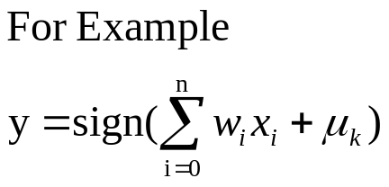
A Neuron (= a perceptron)
-
μ_{k}
x₀
w₀
x₁
w₁
∑
f
output y
x_{n}
w_{n}
Input
vector x
weight
vector w
weighted
sum
Activation
function
The n-dimensional input vector x is mapped into variable y by means of the scalar product and a nonlinear function mapping

Slide 47
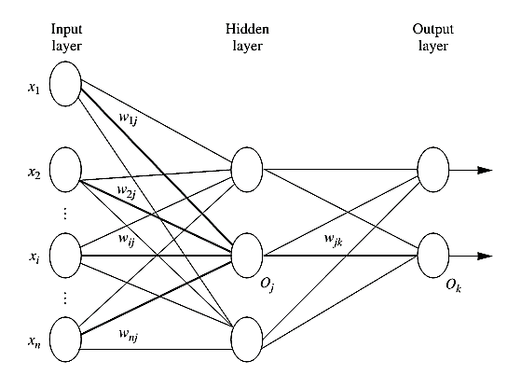
A Multi-Layer Feed-Forward Neural Network

Slide 48
How A Multi-Layer Neural Network Works?
The inputs to the network correspond to the attributes measured for each training tuple
Inputs are fed simultaneously into the units making up the input layer
They are then weighted and fed simultaneously to a hidden layer
The number of hidden layers is arbitrary, although usually only one
The weighted outputs of the last hidden layer are input to units making up the output layer, which emits the network's prediction
The network is feed-forward in that none of the weights cycles back to an input unit or to an output unit of a previous layer
From a statistical point of view, networks perform nonlinear regression: Given enough hidden units and enough training samples, they can closely approximate any function

Slide 49
Defining a Network Topology
First decide the network topology: # of units in the input layer, # of hidden layers (if > 1), # of units in each hidden layer, and # of units in the output layer
Normalizing the input values for each attribute measured in the training tuples to [0.0—1.0]
One input unit per domain value, each initialized to 0
Output, if for classification and more than two classes, one output unit per class is used
Once a network has been trained and its accuracy is unacceptable, repeat the training process with a different network topology or a different set of initial weights

Slide 50
Backpropagation
Iteratively process a set of training tuples & compare the network's prediction with the actual known target value
For each training tuple, the weights are modified to minimize the mean squared error between the network's prediction and the actual target value
Modifications are made in the “backwards” direction: from the output layer, through each hidden layer down to the first hidden layer, hence “backpropagation”
Steps
  Initialize weights (to small random #s) and biases in the network
  Propagate the inputs forward (by applying activation function)
  Backpropagate the error (by updating weights and biases)
  Terminating condition (when error is very small, etc.)

